Slide 1
ISR Class Full Cycle Process

Slide 2

Sourcing
*finding viable candidates
Offer
*creating a req and offer letter/SBS
Interviewing
*scheduling and contacting approved candidates
Onboarding Process
*background check and onboarding docs

Slide 3
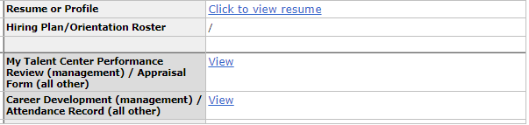
Sourcing
There are three currently sourcing master reqs
2580341826
2028341827
2580341831
When processing and reviewing candidates, hiring managers would like a candidate with any of the following
Excellent candidate: sales experience and a degree
Great candidate: sales experience but no degree
Good candidate: no experience but has a degree
***please take note of which candidates are external and internal, this is important later
When dealing with an internal candidate, they must have three items in their application
Resume
Performance evaluation
Attendance record or Career Development plan

Slide 4
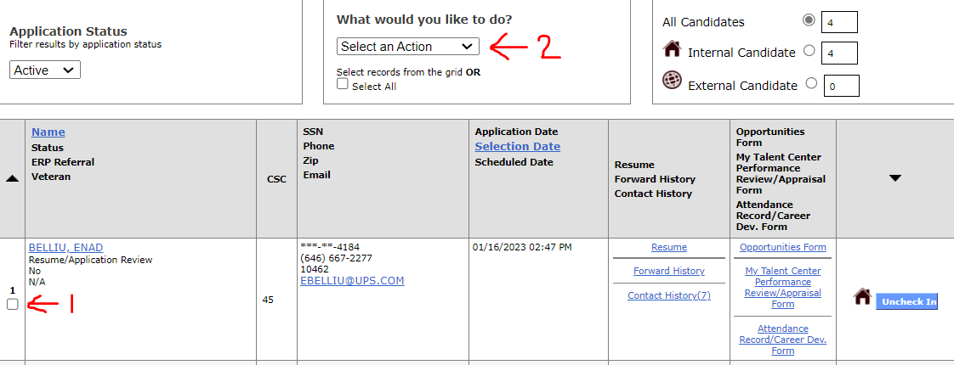

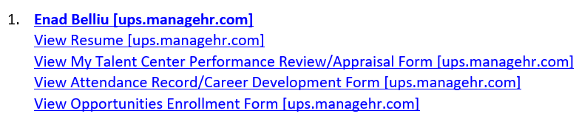
Sourcing
Once a list of candidates are selected, email them to Sean Grear for review
For external candidates, attach their resume to the email
For internal candidates, send the candidate to yourself via AE and copy/paste the link in the email to Shawn as shown in the images
Step 1: click the box of the candidate
Step 2: click the drop down menu and select “Forward to Manager”
Step 3: scroll to the bottom and fill in your email in both boxes
Step 4: copy and paste the link from the automated email sent

Slide 5
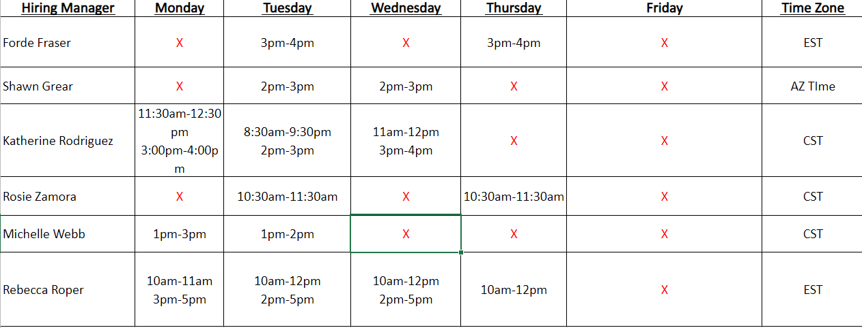
Interviewing
Good Afternoon XXX,
My name is Alex and I am with the UPS Talent Acquisition Team. I have received your resume as a referral for the Inside Sales Representative position, we would like to invite you to interview for the position! Please note that the salary range for this position is $19-25 and hour, which depends on the number of years of sales experience you have, your degree and does not include commission. If the salary range does not fit what you are looking for, negotiation is available however, nothing above $25 per hour is granted. Below are some available interview times, please let me know which interview time you are interested in and I will forward you a Teams meeting invitation.
The start date for this position will be 02/27/2023. Please let me know if you are, or are not interested in interviewing.
After a manager provides feedback…
Disposition candidates that are not selected using the appropriate code depending on the feedback of the manager
Candidates that are selected for an interview, forward an email following the template and call the candidate to confirm

Slide 6
Interviewing
EXTERNAL
Good morning XXX,
Congratulations! Your interview went great and we would like to extend an offer for $XXXX/hour. This is not including commission and is just your base salary, other benefits we offer include a 401K, health, dental and vision.
Your official start date for the Sales Academy will be 02/27/2023 and training is 4 weeks long from 8:30-4:30 CST. Please note that until you graduate from the Sales Academy, that you will be deployed to a territory. Once they are eligible for deployment, you are provided the option to accept or deny the open territory that is available, based on your preferred time zone.
Please let me know if you have any questions. If you are wanting to move forward with this offer, please confirm your mailing/home address.
INTERNAL
Hi Kobi,
Congratulations! Your interview went great and we would like to extend an offer. Because you are already employed with UPS, we will submit for your Side by Side which will consist of your change in pay. It is typically between a 1-3% pay increase from your current pay.
Your official start date for the Sales Academy will be 02/27/2023 and training is 4 weeks long from 8:30-4:30 CST. Please note that until you graduate from the Sales Academy, that you will be deployed to a territory. Once you are eligible for deployment, you are provided the option to accept or deny the open territory that is available, based on your preferred time zone.
Please let me know if you have any questions. If you are wanting to move forward with this offer, please confirm your mailing/home address.
After the interview is scheduled and the interview is complete, the candidate will either be dispositioned or offered
If the candidate is dispositioned, use the appropriate code to disposition
If the candidate is offered, call the candidate and send an email in the following template
Once the candidate commits to this verbal offer, confirm their home/mailing address
Forward Keith Reisen the name of the candidate and their home/mailing address
Request the Req Number and the Workday position ID
CC Bobbie and Rebecca Roper
Keith will create a requisition

Slide 7
Offer
Once the req has been created, assign the correct candidate to the correct req # and attach the correct workday position ID
Reach out to Rebecca to correct dept ID or cost center for the workday position ID to link to AE
ATTACHING THE WORKDAY POSITION ID BEFORE COMPLETING ANY ACTION ON THE CANDIDATE IS CRUCIAL
For the Offer Letter (external)
Send an email to Talent Comp, Belanie, Bobbie and interviewing manager
For the Side by Side (internal)
Let Rebecca know the workday position has been attached to the req and that she can submit for the SBS

Slide 8
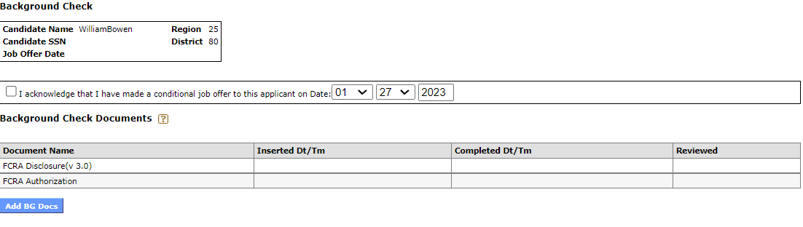
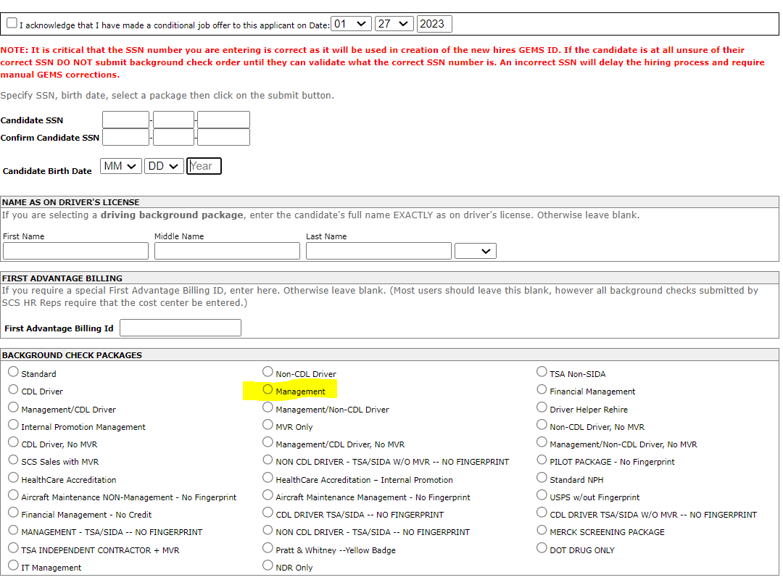
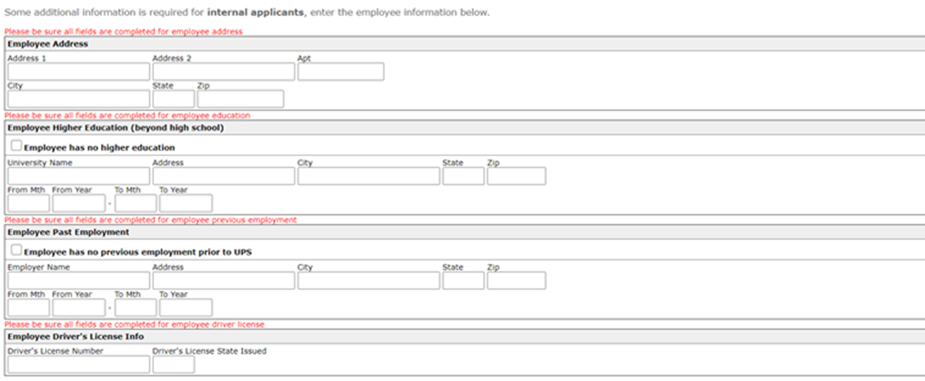
Onboarding (Background Check)
Once the candidate has signed the offer letter or side by side code the candidate to the correct status
After the candidate is coded correctly, attach the FCRA docs
For external
Call the candidates to complete the FCRA docs and retrieve their DOB and SS
For internal
Forward an email with a word doc attached for them to complete the info needed
Both will need a management background check selected
Once the background check clears, move forward with the onboarding docs
External
Internal

Slide 9
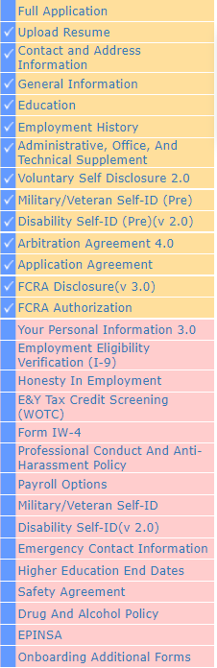
Onboarding (Onboarding Docs/I9 EXTERNAL ONLY)
After the background check has cleared, you are now able to Initiate Express Hire for this candidate
To the right are all the documents for the candidate to complete before their start date
For a walk through of the I9 verification, please review following slides
Once the candidate has completed all the documents please ensure they have been made Pre-Ready for Hire and Hired on the day of their start date
For internal candidates, once their background check has cleared set them to Placement Started on their First start date

Slide 10

I-9 Process for External Hires

Slide 11
I-9 Steps to be completed for external hires
Once an external candidates background has cleared the assigned Recruiter will send an email to the external candidate with instructions to complete additional processing documents. Important: The Recruiter will make the candidate aware of the I-9 process and emails they will be receiving
External candidate will complete all processing documents in their UPS Jobs Application
Once processing documents are completed the candidate will receive a text message along with an email with instructions on how to complete the I-9
Recruiter should send a follow up email to make sure external candidate received the I-9 email

Slide 12
Example of the email the candidate will receive

Slide 13
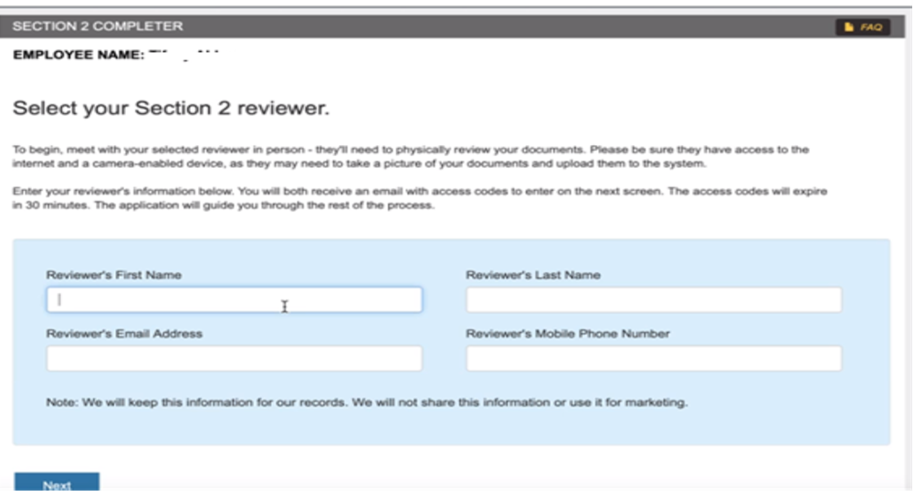
Steps to be completed by candidate and I-9 Reviewer
1. The external candidate will meet with their designated reviewer( Important: I-9 reviewer must be present while completing the I-9). Reviewer can be neighbor, friend, spouse, parent, relative, etc.
2. The email will provide a link to access Section 2 of the external candidates Form I-9: This link provided in the email is specific to the candidate. The below screen will populate asking for the reviewer’s information
3. The reviewer needs to check their email for an access code ( may take a few minutes and let them know to check spam if they did not receive it)

Slide 14
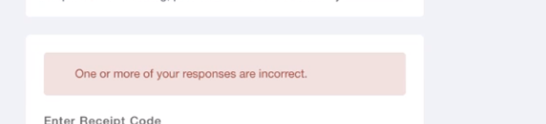
Receipt & Access Code
3. External candidate will need to enter the Receipt Code (This is step 3. listed in the email the external received)
4. External candidate and reviewer must enter their respective access code that was sent in a separate email from I-9Management@equifax.com.
Note: Candidate may get an error like below if they did not input the information correctly. Have them input the information manually.

Slide 15
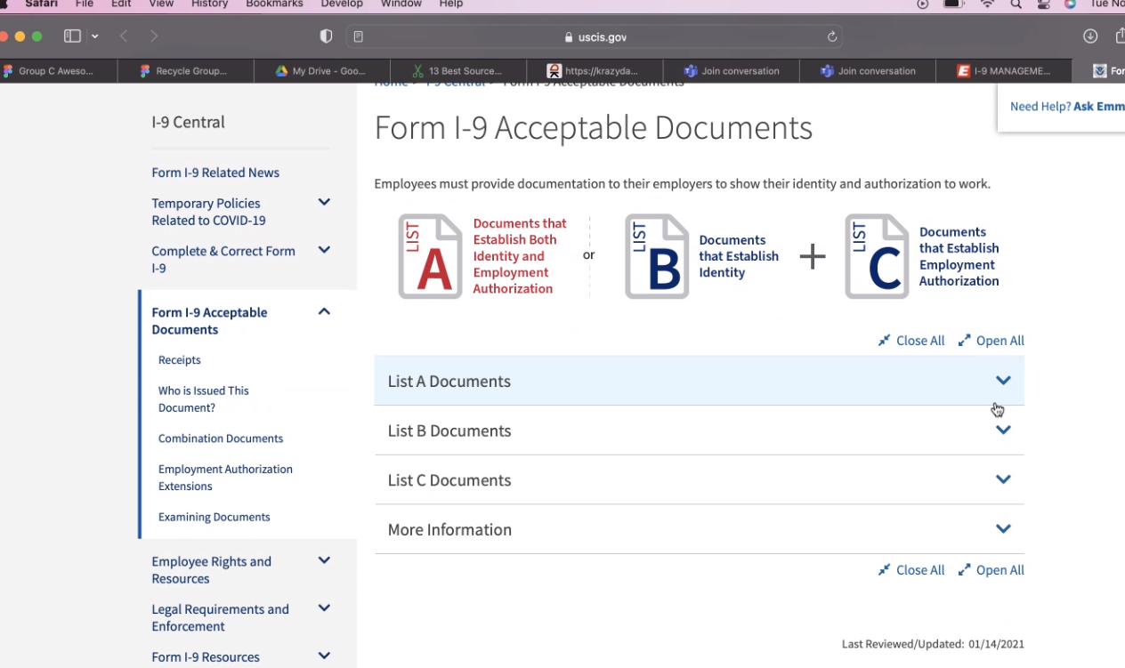
I-9 Acceptable Documents
5. External candidate will share the original documents with the reviewer. Do not share photocopies. Link to acceptable documents is provided in the email. Please see the example where the link will take the candidate.

Slide 16
I-9 Process
6. Both the reviewer and external candidate will complete the steps to complete the I-9
Click Next

Slide 17
I-9 Process example for a Rehire
Note: If the external candidate is a rehire this screen will appear for them to confirm if they are the same person

Slide 18
I-9 Process
7. Based on the document(s) provided, the candidate will select the appropriate selection and identify which documents they are providing to be reviewed

Slide 19
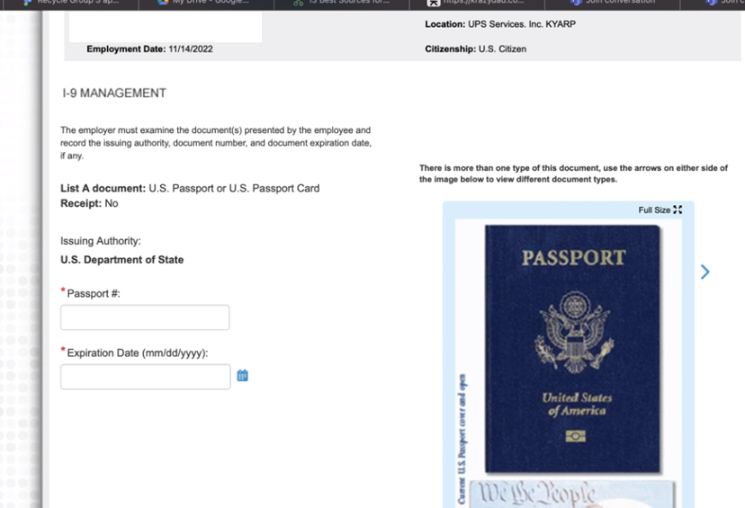
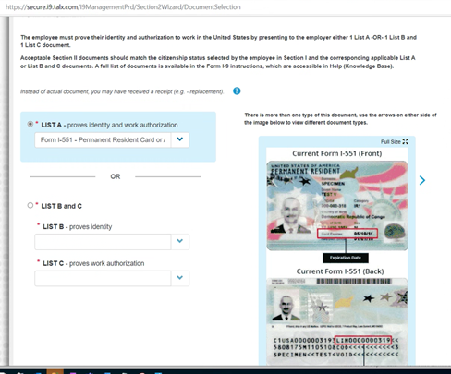
I-9 Process
8. Based on the document provided the candidate will enter the required information

Slide 20
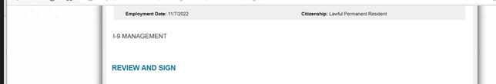
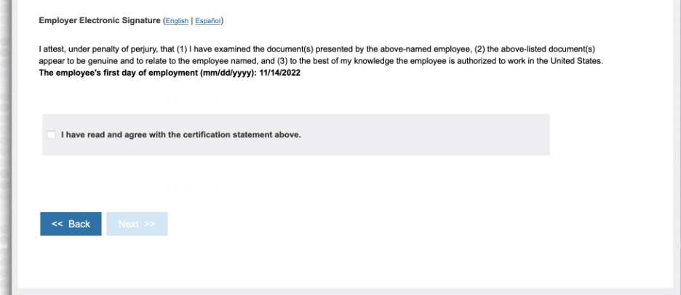
I-9 Process
9. Once you complete, click Next or Continue. The below screen appears to review and confirm information entered is correct. After verified, the reviewer clicks on bottom for electronic signature.

Slide 21
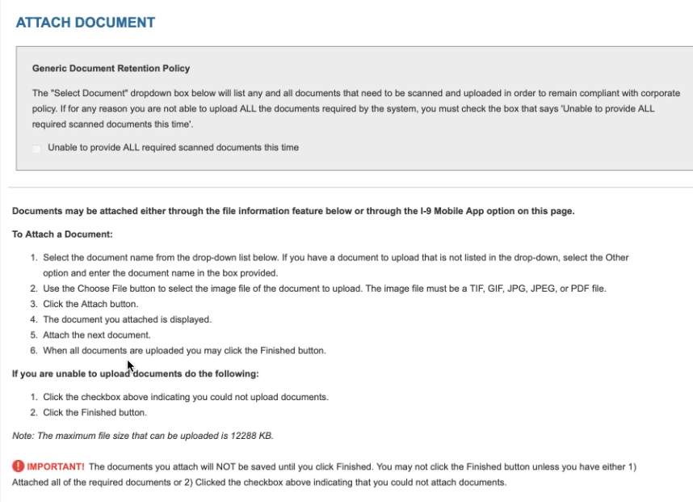
10. Once you click Next, the below screen appears to be able to attach documents. Choose the document you want to attach, click on attach. Screen will appear with copy of the document. Click on Correct to accept the document. ** External candidate can use a mobile device to take pictures. They need to be aware of the Maximum size.
I-9 Process

Slide 22
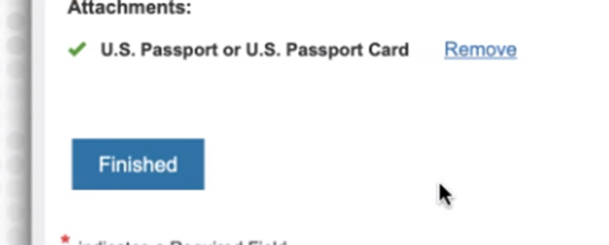
I-9 Process completion
11. Once you complete attaching the documents, click Finish. The below screen appears for the candidate.

